Slide 1
Using Evernote and Google Docs in your web or mobile application
(and potentially Dropbox and Skydrive)
By Peter Messenger
Senior Developer – Triple Point Technology
http://www.petermessenger.com

Slide 2
Why use cloud based storage?
Large user base
  Evernote more than 10 million installs on android per month
  Dropbox has more than 100 million users
  Skydrive has more than 200 million users
Makes it easier for user, can be used anywhere
Previously would output to PDF or RTF (RTF had issues on IOS/Mac OS as they store images differently and you cannot generate files that will work correctly)

Slide 3
What is Evernote?
Evernote allows you to generate notes, save webpages and collaborate with others
Free and paid versions available
Website : http://evernote.com/
Available natively on all major mobile devices (IOS, Android, Blackberry, Windows Phone)
Available on the web and desktops (Mac OS, Windows, Windows 8 and browsers)
Uses XML to store documents, very similar HTML

Slide 4
Evernote Development
Has an API interface to integrate with server
Sdks – Android, IOS, C#, C++, Java, Python, Perl, Ruby and more
Website : http://dev.evernote.com/
Need a developer token, gives access to sandbox (test server), once complete you email support and they switch to production
For simplicity, used the C# sdk
  https://github.com/evernote/evernote-sdk-csharp

Slide 5
Demonstration
Website
  http://www.physiotherapyexercises.com
Uses a single page in the background to connect to evernote, generate the document and copy it back to the server
Integrates into website quite well
Was using XML transforms to generate HTML previously, created a new transform to generate evernote document format

Slide 6
Connecting to Evernote
Evernote supports the same standard OAuth authentication process used by other popular web services like Twitter and Google.
Details :
  http://dev.evernote.com/start/core/authentication.php
Used a helper library for this
  https://github.com/danielcrenna/oauth

Slide 7
Connecting to Evernote
Connect to server passing in
  Username and password
  Callback url
User is taken to logon page, assuming they accept, returns temporary token details to your callback url (this temporary token can last for a long period)
Connect to server again using temporary tokens, get authorisation token
Generate note using authorisation token, get note id, redirect to evernote account so user can view document

Slide 8
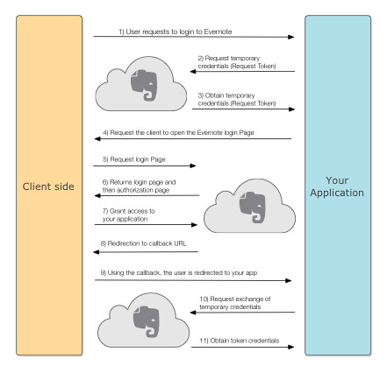
Connecting to Evernote

Slide 9
Evernote document format
Xml, can include attachments
http://dev.evernote.com/start/core/enml.php
  <en-note>
  <h1>Hello, world</h1>
  <en-media width="640" height="480" type="image/jpeg" hash="f03c1c2d96bc67eda02968c8b5af9008"/>
  </en-note>
Hash is the unique identifier for the resource attachment to the note
Supports a whole range of HTML elements

Slide 10
Android Demonstration
Shows how you can use the same api in an android app
Could also do this using android sdk and/or check to see if the user had evernote installed on their phone and open it using the android version rather than the website

Slide 11
Google Docs/Google Drive
Google’s equivalent to microsoft word
Similar to evernote, documents are stored in a variant of HTML
Can then use drive to output to different formats (PDF, Word etc – can be a bit flaky with formatting)
API supports Java, PHP, Javascript, NET, Objective C, Android, Ruby etc
Website : https://developers.google.com/drive/

Slide 12
Google Drive
Quick start for C#
  https://developers.google.com/drive/quickstart-cs
Enable Drive API
  https://code.google.com/apis/console/
  Much like evernote, you need a callback url (this is case sensitive and passing in parameters doesn’t seem to work fully, so use session variables)
  Unlike evernote, the callback url must be specified in the google console
Install the Google Client Library

Slide 13
Google Drive
C# example is for MVC and massively overcomplicates what you need to do
Can pretty much ignore 99% of the example and just use the googleutils class.
You need to store the user credentials in a database or on the server
Uses Oauth, but simpler and all built into library

Slide 14
Demonstration
Website
  http://www.physiotherapyexercises.com
Uses a single page in the background to connect to google drive, generate the document and copy it back to the server
Integrates into website quite well
Was using XML transforms to generate HTML (slightly different to get around formatting limitations)

Slide 15
Generating Document
Can pass in HTML and use the in built conversion routine to save in google docs format
Formatting of tabular data is quite problematic as you can only have one cell style, so end up having tables inside tables to get around it.

Slide 16
Dropbox and Skydrive
Have not implemented these yet (as they are more generic storage options), but they use the same concepts.
Dropbox
  https://www.dropbox.com/developers/reference/sdk
  IOS, Android, Python, Ruby, Java, OS X
  Several third party libraries (php, net, js etc)
Skydrive
  http://msdn.microsoft.com/en-us/library/live/hh826521.aspx

Slide 17
Questions?
Presentation slides on my website and blog
  http://www.petermessenger.com

