Slide 1
Developing Apps for Windows Phone 7
How to get started developing apps, how it compares with Iphone and Android, the pitfalls and what you can expect.
http://www.petermessenger.com

Slide 2
Windows Phone 7
Developed by Microsoft
Available in late 2010
Can develop applications using XNA or Silverlight
XNA
great for 3D, suited for games, very powerful
Silverlight
Much better for text/web type applications, 2D games, easier to develop

Slide 3
Phone Comparison
Android
Can publish without review – “wild west” environment
Develop for free
Fragmented environment (27% 2.1, 64% 2.2, 9% various)
300,000+ apps (17% games), (63% free)
33% Market in 2010, increasing
Iphone
Publish with review, must meet guidelines
$99 US Development Cost
Upgrades keep phones up to date, but still a mix of 3 and 4 (don’t allow publishing of breakdown).
360,000+ apps, (15% games), (36% free)
16% Market in 2010
Windows Phone 7
Publish with review, must meet guidelines
$129 AU Development Cost
Single operating environment
12,500+ apps, (21% games), (36% free)
2% Market in 2010

Slide 4
Developing with XNA/Silverlight
Tools can be downloaded from the App Hub
http://create.msdn.com/en-US/resources/downloads
App hub is also a good play to go for tutorials and guidance
Allowed development via
Visual Studio or Free Equivalents
Can develop on PC for free (emulator of Windows Phone), to be able to run on real phone, you need developer licence $129 AU per year.

Slide 5
Developing with Silverlight – The Good
Benefit from familiar language C#/VB
Very similar to developing with Silverlight
Can share code between Web/desktop versions – efficiency
Can use webservices (this is more difficult when programming Android/Iphone)
Very powerful graphics capability, much more so than Android/Iphone
Submission review process gives good feedback on what you need to fix and why

Slide 6
Developing with Silverlight – The Bad
Much, much lower user base when compared to Iphone/Android
Strict guidelines on “look and feel”, application performance
more work to ensure meets guidelines
can be difficult to meet startup guidelines and get good performance
tombstoning (return back to original state), can be time consuming
http://go.microsoft.com/?linkid=9713252
Still in infancy, marketplace submission process still a bit hit and miss

Slide 7
How to test on a phone
You really need to test your app on a phone – the emulator is much more powerful
Need to unlock the phone via the App Hub
Need Microsoft Zune on your computer (similar to Itunes)
Choose Device instead of emulator from Visual Studio, have Zune running and it will automatically install and you can debug.

Slide 8
Revenue Methods
Free, Trial (limited functionality, entice people to pay) or Paid
Free applications get downloaded 50-100 times more frequently than paid applications, and ad-supported applications earn more revenue than for-fee software.
Advertising available
Microsoft (USA only) - http://advertising.microsoft.com/mobile-apps
Google - https://www.admob.com/
SMAATO (World Wide) - http://www.smaato.com/
AdGac (still in beta) - http://www.adgac.com/
Although one developer has received $28K in four months from advertising in his 14 apps, at this point in time, it is not a path to riches.
Another developer I know, has received less than 1 dollar in ad revenue for his first game in the first month.

Slide 9
Useful tools
Windows Phone Toolkit
Adds more functionality, some controls like long list selector essential for good performance
http://silverlight.codeplex.com/releases/view/52297
Silverlight Analytics Framework
Allows great monitoring and logging, together with google analytics
http://msaf.codeplex.com/
MVVM Lite for Windows Phone
http://mvvmlight.codeplex.com/

Slide 10
Useful Apis
Microsoft Translate – read text back
http://www.microsofttranslator.com/dev/
http://www.silverlight.net/community/samples/silverlight-samples/loud-tweets--a-twitter-to-speak-wp7-app-37017/
Bing Maps
http://www.microsoft.com/maps/developers/web.aspx
Twitter
http://dev.twitter.com/doc
Facebook
http://developers.facebook.com/

Slide 11
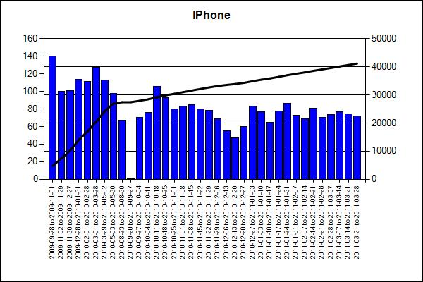
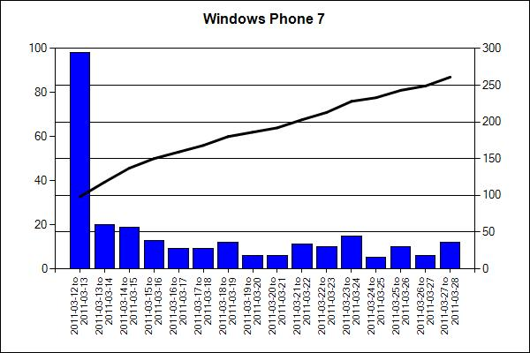
Physiotherapy Exercises
Iphone – 95 per day, WP7 – 15 per day

Slide 12
Helpful links
WP7 apps available
http://wp7applist.com/
WP7 development guide
http://wp7dev.wikispaces.com/
WP7 on Reddit
http://www.reddit.com/r/wp7dev/
General Silverlight links
http://www.silverlight.net/
http://create.msdn.com/en-US/
http://www.silverlight-zone.com/

